Slide 1
Condition-Based Classifier
Houtao Deng
George Runger

Slide 2
Outline
Condition-Based Classifier
The Key Contribution
Previous work and challenges
Condition-based Tree
Experiment results

Slide 3
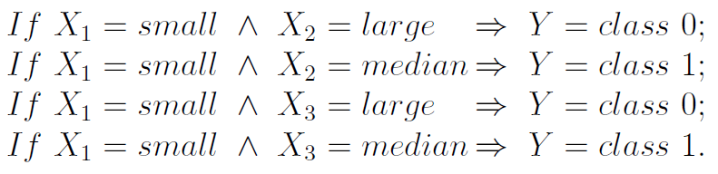
Rule-based classifiers consist of a set of rules.
Rule-based classifiers are comprehensible and enable decision makers to understand and validate the models.
Given similar accuracy performance, a rule-based classifier with a smaller number of rules is favorable.

Slide 4
Condition-based Tree, in general, has many fewer rules than existing rule-based classifiers
We proposed a new rule-based classifier: Condition-based Tree
Over 19 data sets, median of # rules:
7 Rules for Condition-based Tree
13 Rules for Decision Tree
21Rules for Associative Classifier #1
49 Rules for Associative Classifier #2

Slide 5
Outline
Condition-Based Classifier
The Key Contribution
Previous work and challenges
Condition-based Tree
Experiment results

Slide 6
Decision Tree
Refund
Classify if a tax return is a fraud
Yes
No
Tid | Refund | Marital | Taxable | Fraud
 |  | Status | Income
1 | Yes | Single | 125K | No
2 | No | Married | 100K | No
3 | No | Single | 70K | No
4 | Yes | Married | 120K | No
5 | No | Divorced | 95K | Yes
6 | No | Married | 60K | No
7 | Yes | Divorced | 220K | No
8 | No | Single | 85K | Yes
9 | No | Married | 75K | No
10 | No | Single | 90K | Yes
No
MarSt
Non-married
Married
TaxInc
No
< 80K
> 80K
No
Yes
Training Data
Model: Decision Tree

Slide 7
Grow a Decision Tree
At each node, select an attribute that makes the classes in the child nodes as pure as possible.
Refund
Yes
No
The degree of pureness can be measured by Entropy or Gini Index.
No
MarSt
Non-married
Married
TaxInc
No
< 80K
> 80K
No
Yes

Slide 8
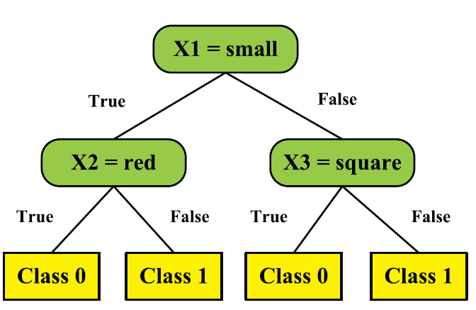
Decision Tree to Rules
A rule is formed by combining the attribute and value pairs in the path from the root node to each leaf.

Slide 9
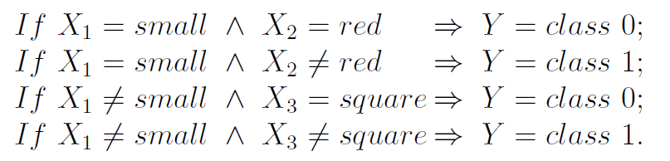
Decision Tree to Rules

Slide 10
Decision Tree to Rules

Slide 11
Decision Tree to Rules

Slide 12
Decision Tree to Rules

Slide 13
Problem of Decision Tree
Only looks at ONE attribute at a time
Can NOT learn the following data: an attribute is useful ONLY when other attributes are present.

Slide 14
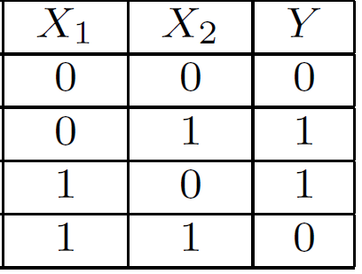
Problem of Decision Tree
Only looks at ONE attribute at a time
Can NOT learn the following data: an attribute is useful ONLY when other attributes are present.
Exclusive or: Y is 1 only when the two attributes are different
X1=0, X2=0 -> Y=0
X1=1, X2=1 -> Y=0
X1=0, X2=1 -> Y=1
X1=1, X2=0 -> Y=1

Slide 15
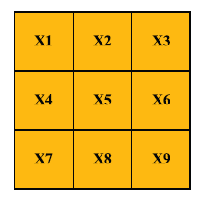
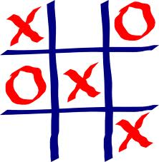
Problem of Decision Tree
Only looks at ONE attribute at a time
Can NOT learn the following data: an attribute is useful ONLY when other attributes are present.
Tic-tac-toe game: to win a game, a player must place three chess pieces in a row (e.g., X1, X5 and X9) before the competitor.

Slide 16
Associative Classifiers
Step 1: Generate a set of classification rules by an association rule algorithm: Apriori
….
Consider multiple attributes at a time
Often a huge number of rules generated

Slide 17
Associative Classifiers
Step 1: Generate a set of classification rules by an association rule algorithm: Apriori
….
The left hand side of a rule is called a condition:
Denoted by C1, C2, C3, C4 …

Slide 18
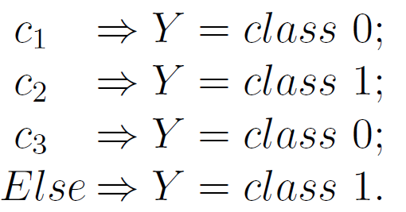
Associative Classifiers
Step 1: Generate a set of classification rules by an association rule algorithm: Apriori
….
Step 2: Select and sort the rules into a classifier

Slide 19
Associative Classifiers
Step 1: Generate a set of classification rules by an association rule algorithm: Apriori
….
CBA: Classification
based on association rule
Step 2: Select and sort the rules into a classifier
GARC: Gain based
Association Rule Classification

Slide 20
Pros and Cons of Associative Classifiers
Pros: consider multiple attributes at a time. Solve the previously mentioned issue of decision tree.
Cons: a huge number of rules can be generated, and the final associative classifier can have a large number of rules.
Data set | # Rules from Tree | # Rules from CBA
austra | 10 | 148
crx | 23 | 142
german | 110 | 172

Slide 21
Outline
Condition-Based Classifier
The Key Contribution
Previous work and challenges
Condition-based Tree
Experiment results

Slide 22
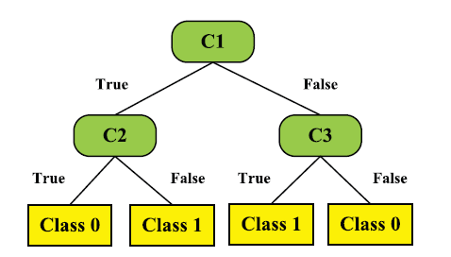
Condition-based Tree: A unified framework for decision tree and associative classifiers
Can be a conjunction of multiple attributes:
X1=small ∧ X2=large
Or a single attribute:
X3=small

Slide 23
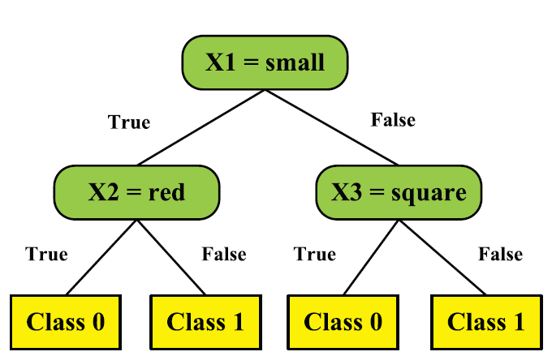
Decision Tree is a special case of condition-based tree
Condition restricted to ONE attribute, value pair

Slide 24
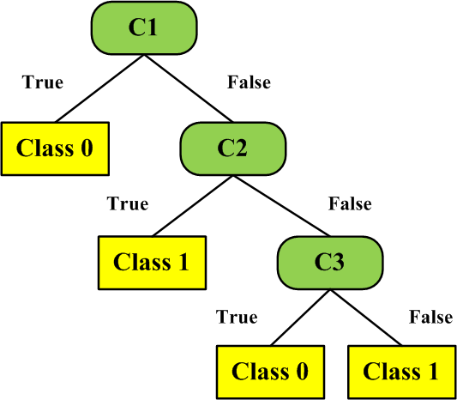
Associative Classifier is a special case of condition-based tree
Tree equivalent to CBA
CBA
Details are in the paper

Slide 25
Associative Classifier is a special case of condition-based tree
Tree equivalent to CBA
Condition-based Tree
The left child node is never split further
Limiting the expressiveness

Slide 26
Condition-based tree relaxes the restrictions
Tree equivalent to CBA
Condition-based Tree
More expressive than
Regular decision tree
Less greedy than

Slide 27
Transform A Condition-based Tree to Rules
C1 ↔ { X1=small ∧ X2=large }
C2 ↔ { X3=small }
C3 ↔ { X4=large }
X1, X2, X3, X4 have three values: small, median and large.

Slide 28
Transform A Condition-based Tree to Rules
Previous method:
C1=True ∧ C2=True → Class 1

Slide 29
Transform A Condition-based Tree to Rules
Previous method:
C1=True ∧ C2=True → Class 1
C1 ↔ { X1=small, X2=large }
C2 ↔ { X3=small }
C3 ↔ { X4=large }
X1=small ∧ X2=large ∧ X3=small → Class 1

Slide 30
Transform A Condition-based Tree to Rules
Previous method:
C1=True ∧ C2=False → Class 1

Slide 31
Transform A Condition-based Tree to Rules
Previous method:
C1=True ∧ C2=False → Class 1
C1 ↔ { X1=small, X2=large }
C2 ↔ { X3=small }
C3 ↔ { X4=large }
X1=small ∧ X2=large ∧ X3 !=small → Class 1

Slide 32
Transform A Condition-based Tree to Rules
Previous method:
C1=True ∧ C2=False → Class 1
C1 ↔ { X1=small, X2=large }
C2 ↔ { X3=small }
C3 ↔ { X4=large }
X1=small ∧ X2=large ∧ X3 !=small → Class 1
Increased to 2 rules
X1=small ∧ X2=large ∧ X3 = large → Class 1 or
X1=small ∧ X2=large ∧ X3 = median→ Class 1

Slide 33
Transform A Condition-based Tree to Rules
Previous method:
C1=True ∧ C2=False → Class 1
“FALSE” produces the trouble!
X1=small ∧ X2=large ∧ X3 !=small → Class 1
Increased to 2 rules
X1=small ∧ X2=large ∧ X3 = large → Class 1 or
X1=small ∧ X2=large ∧ X3 = median→ Class 1

Slide 34
Transform A Condition-based Tree to Rules
Our method:
Step 1:
Arrange the “True” as the left child node.
Step 2: Visit the tree bottom-up and left-right:
A rule is extracted from the root node to each leaf, and the conditions with FALSE value can be omitted in the rule!
Proved in paper

Slide 35
Transform A Condition-based Tree to Rules
Our method:
C1=TRUE ∧ C2=TRUE → Class 0

Slide 36
Transform A Condition-based Tree to Rules
Our method:
C1=TRUE ∧ C2=TRUE → Class 0
C1=TRUE → Class 1

Slide 37
Transform A Condition-based Tree to Rules
Our method:
C1=TRUE ∧ C2=TRUE → Class 0
C1=TRUE → Class 1
C3=TRUE → Class 1

Slide 38
Transform A Condition-based Tree to Rules
Our method:
C1=TRUE ∧ C2=TRUE → Class 0
C1=TRUE → Class 1
C3=TRUE → Class 1
Else → Class 0

Slide 39
Transform A Condition-based Tree to Rules
Our method:
C1=TRUE ∧ C2=TRUE → Class 0
C1=TRUE → Class 1
C3=TRUE → Class 1
Else → Class 0
X1=small ∧ X2=large ∧ X3=small → Class 0
X1=small ∧ X2=large → Class 1
X4=large → Class 1
Else → Class 0
“FALSE” is avoided!
# rules maintains the same

Slide 40
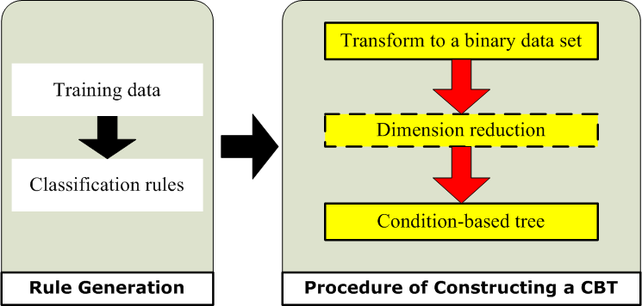
Construct a condition-based tree

Slide 41
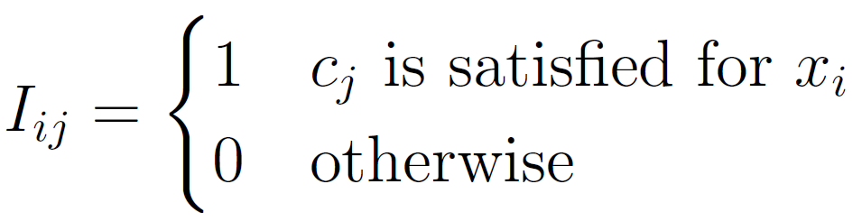
Construct a condition-based Tree
Step 1: Data Transform
A set of training cases: D: {X_{i},y_{i}}, i={1,…,n}
A set of classification rules:
{c₁ -> y₁, c₂ -> y₂, …, c_{m} -> y_{m}}
Create a new data matrix D’=[I,Y],
the entry I_{ij} is an indicator variable whether a condition c_{j} is satisfied for X_{i}

Slide 42
Example
Conditions |  | Class
C1 | {V1=0} | y=0
C2 | {V2=0} | y=0
C3 | {V2=1} | y=0
C4 | {V1=1} | y=0
C5 | {V1=0,V2=0} | y=0
C6 | {V1=1,V2=1} | y=0
C7 | {V1=0} | y=1
C8 | {V2=0} | y=1
C9 | {V2=1} | y=1
C10 | {V1=1} | y=1
C11 | {V1=0,V2=1} | y=1
C12 | {V1=1,V2=0} | y=1
V1 | V2 | Class
0 | 0 | 0
0 | 1 | 1
1 | 0 | 1
1 | 1 | 0
???
C1 | C2 | … | C12 | Class
Training data
Transformed data
Classification rules
Notes:
Both C4.5 and CBA are ranked as top algorithms in IEEE International Conference on Data Mining 2006

Slide 43
Example
Conditions |  | Class
C1 | {V1=0} | Y=0
C2 | {V2=0} | Y=0
C3 | {V2=1} | Y=0
C4 | {V1=1} | Y=0
C5 | {V1=0,V2=0} | Y=0
C6 | {V1=1,V2=1} | Y=0
C7 | {V1=0} | Y=1
C8 | {V2=0} | Y=1
C9 | {V2=1} | Y=1
C10 | {V1=1} | Y=1
C11 | {V1=0,V2=1} | Y=1
C12 | {V1=1,V2=0} | Y=1
If instance 1 satisfies c1
V1 | V2 | Class
0 | 0 | 0
0 | 1 | 1
1 | 0 | 1
1 | 1 | 0
C1 | C2 | … | C12 | Class
1
Training data
Transformed data
Classification rules
Notes:
Both C4.5 and CBA are ranked as top algorithms in IEEE International Conference on Data Mining 2006

Slide 44
Example
Conditions |  | Class
C1 | {V1=0} | Y=0
C2 | {V2=0} | Y=0
C3 | {V2=1} | Y=0
C4 | {V1=1} | Y=0
C5 | {V1=0,V2=0} | Y=0
C6 | {V1=1,V2=1} | Y=0
C7 | {V1=0} | Y=1
C8 | {V2=0} | Y=1
C9 | {V2=1} | Y=1
C10 | {V1=1} | Y=1
C11 | {V1=0,V2=1} | Y=1
C12 | {V1=1,V2=0} | Y=1
If instance 2 satisfies c1
V1 | V2 | Class
0 | 0 | 0
0 | 1 | 1
1 | 0 | 1
1 | 1 | 0
C1 | C2 | … | C12 | Class
1
1
Training data
Transformed data
Classification rules
Notes:
Both C4.5 and CBA are ranked as top algorithms in IEEE International Conference on Data Mining 2006

Slide 45
Example
Conditions |  | Class
C1 | {V1=0} | Y=0
C2 | {V2=0} | Y=0
C3 | {V2=1} | Y=0
C4 | {V1=1} | Y=0
C5 | {V1=0,V2=0} | Y=0
C6 | {V1=1,V2=1} | Y=0
C7 | {V1=0} | Y=1
C8 | {V2=0} | Y=1
C9 | {V2=1} | Y=1
C10 | {V1=1} | Y=1
C11 | {V1=0,V2=1} | Y=1
C12 | {V1=1,V2=0} | Y=1
If instance 3 satisfies c1
V1 | V2 | Class
0 | 0 | 0
0 | 1 | 1
1 | 0 | 1
1 | 1 | 0
C1 | C2 | … | C12 | Class
1
1
0
Training data
Transformed data
Classification rules
Notes:
Both C4.5 and CBA are ranked as top algorithms in IEEE International Conference on Data Mining 2006

Slide 46
Example
Conditions |  | Class
C1 | {V1=0} | Y=0
C2 | {V2=0} | Y=0
C3 | {V2=1} | Y=0
C4 | {V1=1} | Y=0
C5 | {V1=0,V2=0} | Y=0
C6 | {V1=1,V2=1} | Y=0
C7 | {V1=0} | Y=1
C8 | {V2=0} | Y=1
C9 | {V2=1} | Y=1
C10 | {V1=1} | Y=1
C11 | {V1=0,V2=1} | Y=1
C12 | {V1=1,V2=0} | Y=1
If instance 4 satisfies c1
V1 | V2 | Class
0 | 0 | 0
0 | 1 | 1
1 | 0 | 1
1 | 1 | 0
C1 | C2 | … | C12 | Class
1
1
0
0
Training data
Transformed data
Classification rules
Notes:
Both C4.5 and CBA are ranked as top algorithms in IEEE International Conference on Data Mining 2006

Slide 47
Example
Conditions |  | Class
C1 | {V1=0} | Y=0
C2 | {V2=0} | Y=0
C3 | {V2=1} | Y=0
C4 | {V1=1} | Y=0
C5 | {V1=0,V2=0} | Y=0
C6 | {V1=1,V2=1} | Y=0
C7 | {V1=0} | Y=1
C8 | {V2=0} | Y=1
C9 | {V2=1} | Y=1
C10 | {V1=1} | Y=1
C11 | {V1=0,V2=1} | Y=1
C12 | {V1=1,V2=0} | Y=1
If instance 1 satisfies c2
V1 | V2 | Class
0 | 0 | 0
0 | 1 | 1
1 | 0 | 1
1 | 1 | 0
C1 | C2 | … | C12 | Class
1 | 1
1
0
0
Training data
Transformed data
Classification rules
Notes:
Both C4.5 and CBA are ranked as top algorithms in IEEE International Conference on Data Mining 2006

Slide 48
Example
Conditions |  | Class
C1 | {V1=0} | Y=0
C2 | {V2=0} | Y=0
C3 | {V2=1} | Y=0
C4 | {V1=1} | Y=0
C5 | {V1=0,V2=0} | Y=0
C6 | {V1=1,V2=1} | Y=0
C7 | {V1=0} | Y=1
C8 | {V2=0} | Y=1
C9 | {V2=1} | Y=1
C10 | {V1=1} | Y=1
C11 | {V1=0,V2=1} | Y=1
C12 | {V1=1,V2=0} | Y=1
V1 | V2 | Class
0 | 0 | 0
0 | 1 | 1
1 | 0 | 1
1 | 1 | 0
C1 | C2 | … | C12 | Class
1 | 1 | … | 0
1 | 0 | … | 0
0 | 1 | … | 1
0 | 0 | … | 0
Training data
Transformed data
Classification rules
Notes:
Both C4.5 and CBA are ranked as top algorithms in IEEE International Conference on Data Mining 2006

Slide 49
Example
# rows = # rows of the original data
# columns = # rule conditions + 1 (the class)
Conditions |  | Class
C1 | {V1=0} | Y=0
C2 | {V2=0} | Y=0
C3 | {V2=1} | Y=0
C4 | {V1=1} | Y=0
C5 | {V1=0,V2=0} | Y=0
C6 | {V1=1,V2=1} | Y=0
C7 | {V1=0} | Y=1
C8 | {V2=0} | Y=1
C9 | {V2=1} | Y=1
C10 | {V1=1} | Y=1
C11 | {V1=0,V2=1} | Y=1
C12 | {V1=1,V2=0} | Y=1
V1 | V2 | Class
0 | 0 | 0
0 | 1 | 1
1 | 0 | 1
1 | 1 | 0
C1 | C2 | … | C12 | Class
1 | 1 | … | 0 | 0
1 | 0 | … | 0 | 1
0 | 1 | … | 1 | 1
0 | 0 | … | 0 | 0
Training data
Transformed data
Classification rules
Notes:
Both C4.5 and CBA are ranked as top algorithms in IEEE International Conference on Data Mining 2006

Slide 50
Construct a Condition-based Tree
Step 2: Dimension Reduction
Apply feature selection to the new data to reduce the number of attributes
Feature selection:
Eliminate irrelevant and redundant attributes
Feature selection
Original data
Reduced data

Slide 51
Construct a Condition-based Tree
Step 3: Construct condition-based tree
Apply a regular decision tree to the new data
C1 | C2 | … | C12 | Class
1 | 1 | … | 0 | 0
1 | 0 | … | 0 | 1
0 | 1 | … | 1 | 1
0 | 0 | … | 0 | 0
Decision tree
Condition-based tree

Slide 52
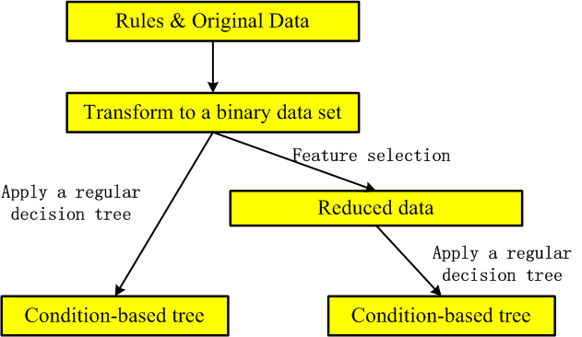
Summary of Constructing A Condition-based Tree
CBT
CBT-FS

Slide 53
Outline
My research and product development experiences
Topic of Today: Condition-Based Tree Classifier
The Key Contribution
Previous work and challenges
Condition-based Tree
Experiment results
Future Work

Slide 54
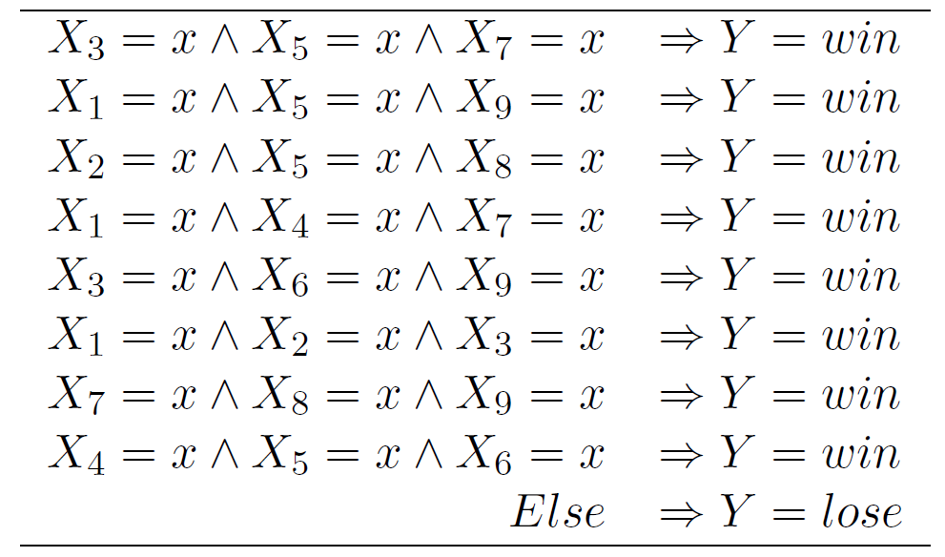
Data 1: Tic-tac-toe game
Condition-based tree
Decision tree has 100 rules

Slide 55
Data 2: Labor contract classification
The data set includes all collective agreements reached in the business and personal services sector for local unions in Canada.
There are 16 attributes including the information about wage increases, employer’s
contributions to the pension plan, etc.
The class is either good or bad, which standards for an acceptable or unacceptable contract, respectively.

Slide 56
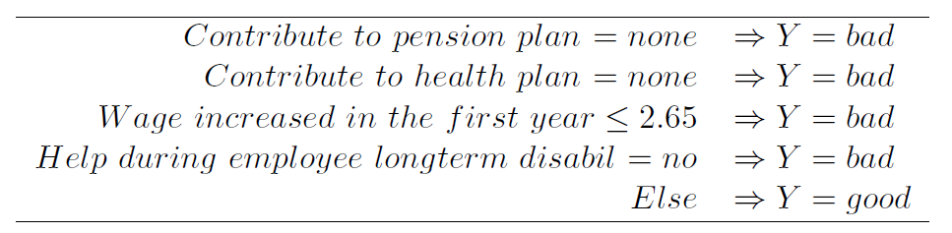
Data 2: Labor contract classification
The data set includes all collective agreements reached in the business and personal services sector for local unions in Canada.
There are 16 attributes including the information about wage increases, employer’s
contributions to the pension plan, etc.
The class is either good or bad, which standards for an acceptable or unacceptable contract, respectively.
Condition-based tree

Slide 57
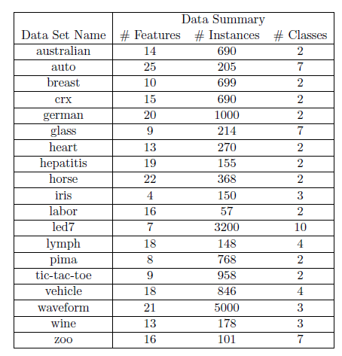
More data sets and Methods
Condition-based Tree with feature selection: CBT-FS
Condition-based Tree without feature selection: CBT
Decision Tree: C4.5
Associative classifier 1: CBA
Associative classifier 2: GARC

Slide 58
Results: #rules from each classifier
# rules
Data Sets
Methods

Slide 59
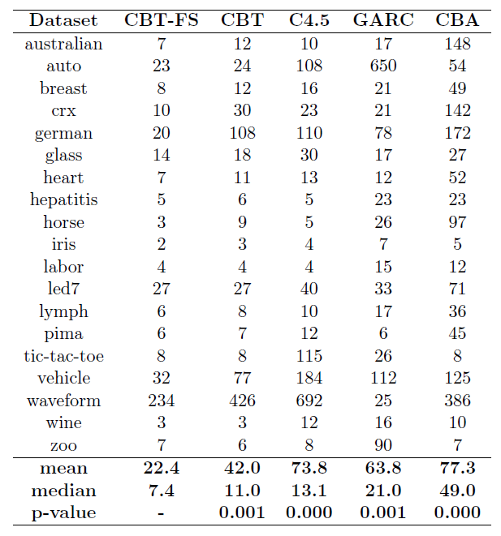
Results: #rules from each classifier
In terms of average number of rules:
CBT-FS and CBT are better than C4.5, GARC and CBA

Slide 60
Results: #rules from each classifier
In terms of the medium of # rules:
CBT-FS and CBT are better than C4.5, GARC and CBA

Slide 61
In terms of Wilcoxon signed-rank tests: CBT-FS and CBT have significantly fewer rules than decision tree C4.5, GARC and CBA (significance level of 0.001)
Results: #rules from each classifier
Wilcoxon signed-rank tests

Slide 62
Results: cross-validation error rates from each classifier
Error
Data Sets
Methods

Slide 63
Summary
Propose the condition-based tree, a unified framework for decision trees and associative classifiers
Propose a way to extract rules from a condition-based tree
Propose a way to construct a condition-based tree
Experimental study shows that condition-based trees produce a substantially smaller number of rules than existing methods, which leads to better comprehensibility.

Slide 64
References
H. Deng, G. Runger, E. Tuv, W. Bannister, under review, Decision Support Systems, 2013
Tan, Steinbach, Kumar, Lectures of Introduction to Data Mining
Agrawal, R., Srikant, R., 1994. Fast algorithms for mining association rules. In: Proc. 20th Int. Conf. Very Large Data Bases, VLDB. Vol. 1215. pp. 487–499.
Chen, G., Liu, H., Yu, L., Wei, Q., Zhang, X., 2006. A new approach to classification based on association rule mining. Decision Support Systems 42 (2), 674–689.
Liu, B., Hsu, W., Ma, Y., Aug 1998. Integrating classification and association rule mining. In: KDD-98.

